Slide 1
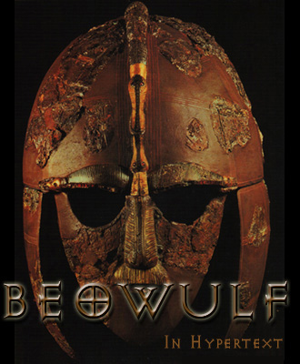

Slide 2
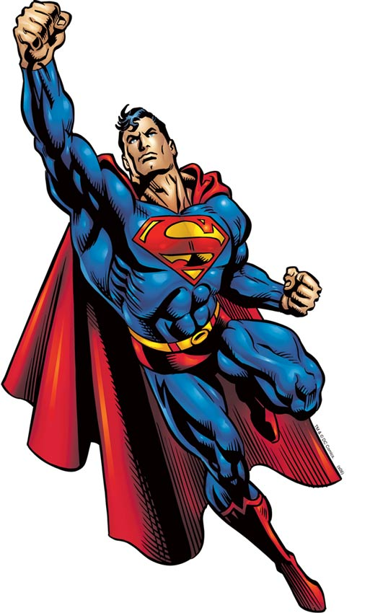
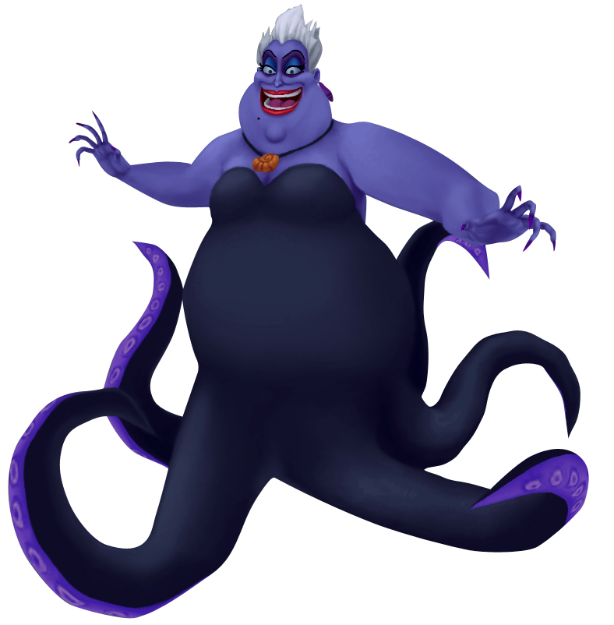
Heroes and Villains
VS

Slide 3
Warrior Culture
What is a “warrior”?
What is a “Warrior Culture”?
Who, based on History, would be a “warrior”?
*Samurais *Spartans *Apaches
*Romans
*Knights

Slide 4
Warrior Cultures
Samurai The samurai warriors emphasized honor and correct action to the greatest extremes. Although they were most commonly used as highly skilled mounted archers in battle, the samurai have become synonymous with the katana, an exquisitely-crafted sword that is regarded as a part of the samurai's soul. The skill of a samurai with this sword is unmatched. Samurai meditated upon their death, and the wisdom that they were already dead, in order to throw themselves into battle without fear.

Slide 5
Warrior Cultures
Spartans The Spartan city-state is without question one of the greatest warrior cultures in human history. Any weakness was intolerable to the Spartans. Their warriors were feared and marveled at among all the Greek city-states of the time, including the Spartan women. The failing of the Spartan society did not lie in the skill of the warriors but in their dwindling numbers. Spartans were running a population deficit, and the entire society was propped up with a massive majority of slaves and helots. However the skill and ferocity of their citizen warriors cannot be overlooked. At the peak of Sparta's glory, no army could stand against the Spartans in combat.

Slide 6
Warrior Culture
Apache The Apache warriors are still legendary for their fierceness, relentlessness, and the hardship of their upbringing. Young Apache warriors were tested almost to the point of destruction. Boys were often trained to go without sleep, to sit for long periods of time without moving or making a sound. There are common stories of Apache boys being required to run miles across the desert with a mouthful of water, and then to spit the mouthful of water out at the end of their run. Apache fought with relatively primitive weapons, but even armed with only a knife this was a warrior to be feared.

Slide 7
Warrior Cultures
Romans Of all the warrior cultures - the Romans were perhaps the most pragmatic. The Roman military took whatever worked and gradually made it into their own. A prime example is the phalanx formation which the Romans "borrowed" from the Greeks, used to great effect, and then summarily abandoned when it was outdated. This adaptability, along with overwhelming numbers, explains much of the success the Roman armies enjoyed for a very long period of time. Roman military did emphasize honor, but this warrior culture can perhaps best be thought of in a machine paradigm, spreading to the four corners of the known world, conquering, recruiting, learning, and adapting.

Slide 8
Warrior Cultures
Knights Honor was the cornerstone concept for knights of the medieval era. The code of the knights was to: "Protect the weak, defenseless, helpless, and fight for the general welfare of all." This concept of honor above all was a critical component in the psychological makeup of these gentlemen soldiers. Knights fought in massive suits of armor, usually weighing 40-60 pounds, although some plate armor is estimated to have weighed more than 100 pounds! An armored knight on armored horse would have been like a tank on the battlefield.

Slide 9
Beowulf
Poet unknown
Anglo-Saxon and Old English
*The term Anglo-Saxon is used by some historians to designate the Germanic tribes who invaded and settled the south and east of Britain beginning in the early 5th century
Christian (but with a bit of pagan tradition)
Epic poem (with 3,182 lines)
Epic = a very long poem that tells the adventures of a hero
Epic Hero = a larger-than-life character who has great adventures, often boasts, and values personal appearance/identity

Slide 10
Characteristics of Epic Hero
Is significant and glorified
Is on a quest
Has superior or supernhuman strength, intelligence, and/or courage
Is ethical
Risks death for glory or for the greater good of society
Performs brave deeds
Is a strong and responsible leader
Reflects the ideals of a particular society

Slide 11
Beowulf – one of few pieces that survived. Priests and monks were the only ones who could write; stories survival depended upon them. The church was not too eager to preserve literature that was pagan in nature, so historians believe they either ignored it or changed it. This may account for the mixture of Christian and pagan elements in Beowulf.

Slide 12
Old English Poetics
Alliteration – repetition of consonant and vowel sounds at the beginning of words
Caesura – a natural pause or break in the middle of the line of poetry and joined by the use of a repeated vowel or consonant sound
Out of the marsh // from the foot of misty
Hills and bogs // bearing God’s hatred
Grendel came // hoping to kill
Anyone he could trap // on this trip to high Herot

Slide 13
Old English Poetics
Kenning: The term derives from the use of the Old Norse verb kenna 'to know, recognize'…It is a device for introducing descriptive color or for suggesting associations without distracting attention from the essential statement. [Cuddon offers the following instances of Old English kennings:
a) helmberend—"helmet bearer" = "warrior"
b) beadoleoma—"battle light" = "flashing sword"
c) swansrad—"swan road" = "sea"
Essentially, then, a kenning is a compact metaphor that functions as a name or epithet; it is also, in its more complex forms, a riddle in miniature.]

Slide 14
Old English
Hwæt! We Gardena in geardagum, þeodcyninga, þrym gefrunon, hu ða æþelingas ellen fremedon. Oft Scyld Scefing sceaþena þreatum,
monegum mægþum, meodosetla ofteah, egsode eorlas. Syððan ærest wearð feasceaft funden, he þæs frofre gebad, weox under wolcnum, weorðmyndum þah, oðþæt him æghwylc þara ymbsittendra
ofer hronrade hyran scolde, gomban gyldan. þæt wæs god cyning! Ðæm eafera wæs æfter cenned, geong in geardum, þone god sende folce to frofre; fyrenðearfe ongeat
15 þe hie ær drugon aldorlease
lange hwile. Him þæs liffrea, wuldres wealdend, woroldare forgeaf; Beowulf wæs breme

Slide 15
Modern English
LO, praise of the prowess of people-kings of spear-armed Danes, in days long sped, we have heard, and what honor the athelings won! Oft Scyld the Scefing from squadroned foes, from many a tribe, the mead-bench tore, awing the earls. Since erst he lay friendless, a foundling, fate repaid him: for he waxed under welkin, in wealth he throve, till before him the folk, both far and near, who house by the whale-path, heard his mandate, gave him gifts: a good king he! To him an heir was afterward born, a son in his halls, whom heaven sent to favor the folk, feeling their woe that erst they had lacked an earl for leader so long a while; the Lord endowed him, the Wielder of Wonder, with world's renown. Famed was this Beowulf:

Slide 16
Comparison
Hwæt! We Gardena in geardagum,
þeodcyninga, þrym gefrunon,
hu ða æþelingas ellen fremedon.
LO, praise of the prowess of people-kings
of spear-armed Danes, in days long sped,
we have heard, and what honor the athelings won!
They’re Both English!

Slide 17
Old English
hus house
hwæt wheat
weall wall
wer man
wulf wolf
engel angel
bedd bed
blæc black

